Slide 1
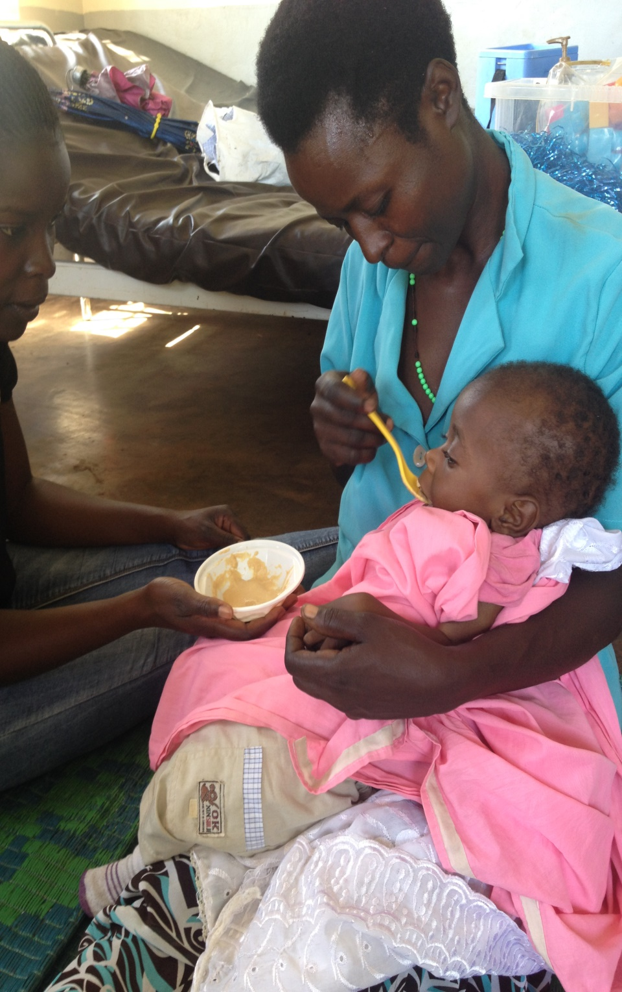
​​Ubuntu Hub Shared Learning Webinar Series: Exploring feeding challenges for children with developmental disabilities Wednesday 10th May 1-2pm GMT
This will be an engaging one hour webinar exploring feeding challenges for children with developmental disabilities
It will include a short presentation on USAIDs current work on nutrition and feeding resources for children with developmental disabilities. Followed by a global expert panel discussion of 3 case studies covering different feeding challenges commonly experienced by children with disabilities and their caregivers.
Malia Uyehara, Project officer, USAID Advancing Nutrition
Melanie Adams, Independent Consultant – International Training and Disability, MAITS
Snehal Omkar Talvekar (Occupational Therapist) & Roohina Mohd Zahid Shaikh (Physiotherapist), Ummeed Child Development Centre, Mumbia, India.
Kate Miller, speech-language pathologist and Feeding & Disability Specialist with SPOON
Attendees will learn and share ideas on:
The importance of addressing the complex challenges of feeding and malnutrition in children with developmental disabilities
Holistic strategies to address feeding challenges and support child and caregiver wellbeing
Available recourses related to feeding and malnutrition for children with developmental disabilities
Have the opportunity to share ideas and learning with global expert panel
Free and open to all. No registration required. A recording of this session will be available after the event
Link here: https://lshtm.zoom.us/j/96033466018

